Slide 1

SQL for DAML

Slide 2
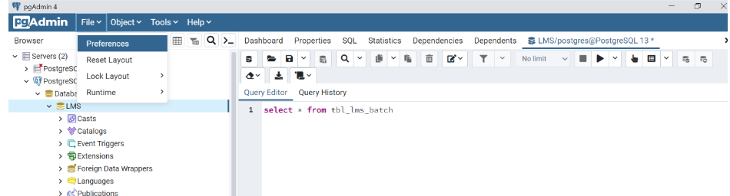
PostgreSQL Installation Guide
Steps to install PostgreSQL on your local system can be found in the below link.
Windows
https://www.postgresqltutorial.com/install-postgresql/
MacOS
https://www.postgresqltutorial.com/install-postgresql-macos/
Steps to connect to PostgreSQL Database Server
https://www.postgresqltutorial.com/connect-to-postgresql-database/
Flow the steps to connect to PostgreSQL database server using pgAdmin
Setting up the binary path
Click on File->Preferences as shown

Slide 3
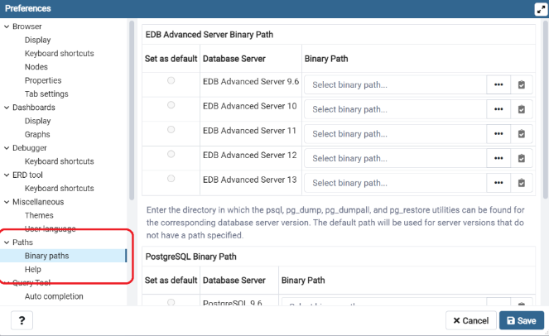
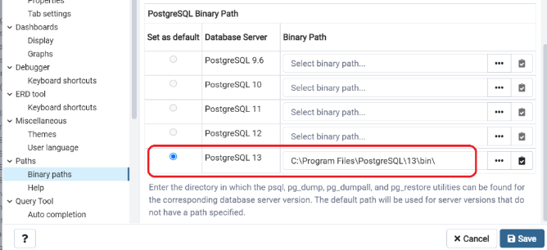
Select Binary path as shown
Scroll below and set the binary path as shown below

Slide 4
STEPS TO DOWNLOAD AND INSTALL SAMPLE DATABASE
Download the PostgreSQL sample database
You can download the PostgreSQL DVD Rental sample database via the following link:
Download DVD Rental Sample Database
The database file is in zip format ( dvdrental.zip) so you need to extract it to dvdrental.tar before loading the sample database into the PostgreSQL database server.
Download printable ER diagram
You can download and print the ER diagram for reference while practicing PostgreSQL.
Download the Printable ER Diagram
Load PostgreSQL Sample Database
Go to this link https://www.postgresqltutorial.com/postgresql-getting-started/load-postgresql-sample-database/ and follow steps to
load the DVD Rental database using the pgAdmin.

Slide 5
Chapter 1: Intro to DBMS/RDBMS
Introduction of DBMS/RDBMS concepts/definitions
Brief intro about popular DB’s
SQL Intro
Create, Insert, Update, Delete, Truncate, Drop SQL statements
Chapter 2: Queries
Select, where, Distinct, Order by, Like
Alias as, Between, And, OR, Wildcard-%, Null values
Chapter 3: Aggregate Functions
Count, Min/Max, Group by
Avg, Sum, Having
Chapter 4: SQL Joins and Sub queries
Inner Join
Left Join
Right Join
Self Join
Cross Join
Sub queries

Slide 6
Chapter 5: Views
Chapter 6: Index
Chapter 7: Triggers
Chapter 8: Procedure

Slide 7
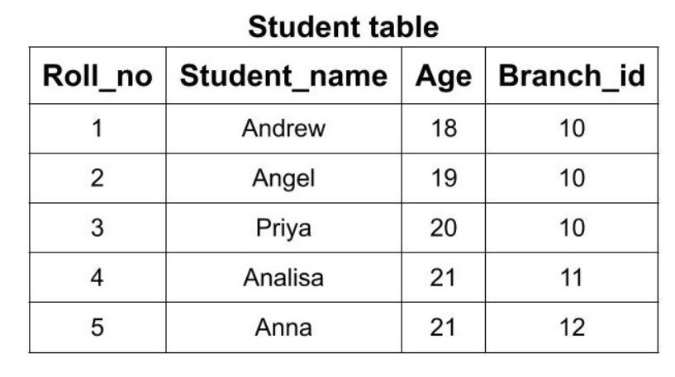
Chapter 1: Intro to DBMS/RDBMS
What is Database?
A database is typically designed so that it is easy to store and access information.
A good database is crucial to any company or organization. This is because the database stores all the relevant details about the company such as employee records, transactional records, salary details etc.
Initial days people are storing the data in the form of files. Ex: Text files . Later Excel files.
What is DBMS?
Database management system (DBMS):
We can store the data in the form of tables in the hard Drive.

Slide 8
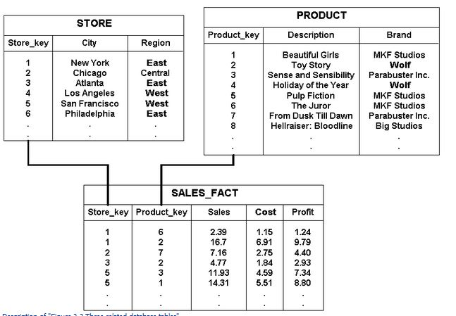
What is RDBMS?
RDBMS stands for Relational Database Management System. RDBMS is the basis for SQL, and for all modern database systems like MS SQL Server, IBM DB2, Oracle, MySQL, PostgreSQL, sand Microsoft Access.

Slide 9
What is SQL?
SQL stands for Structured Query Language
SQL lets you access and manipulate databases
What Can SQL do?
SQL can execute queries against a database
SQL can retrieve data from a database
SQL can insert records in a database
SQL can update records in a database
SQL can delete records from a database
SQL Consists of
Data Manipulation Language(DML)
SELECT, INSERT, UPDATE, DELETE
Data Definition Language(DDL)
CREATE, DROP, ALTER

Slide 10
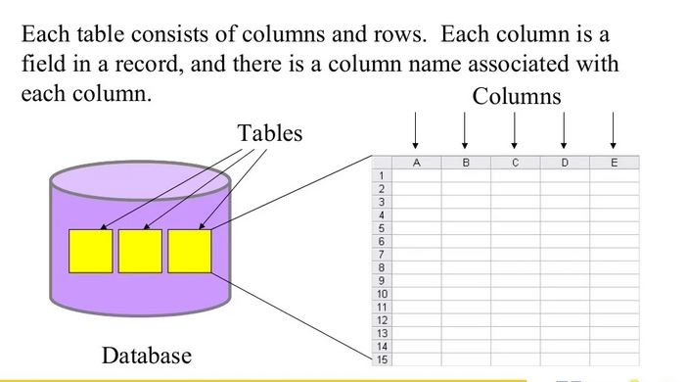
Database Basics

Slide 11
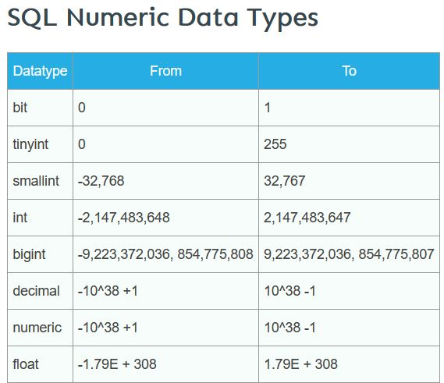
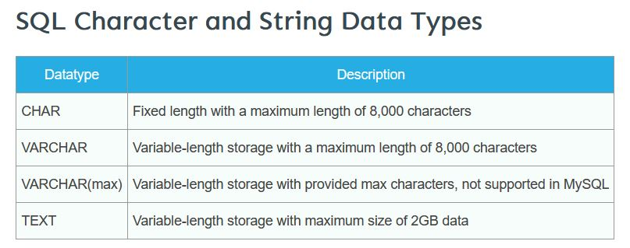
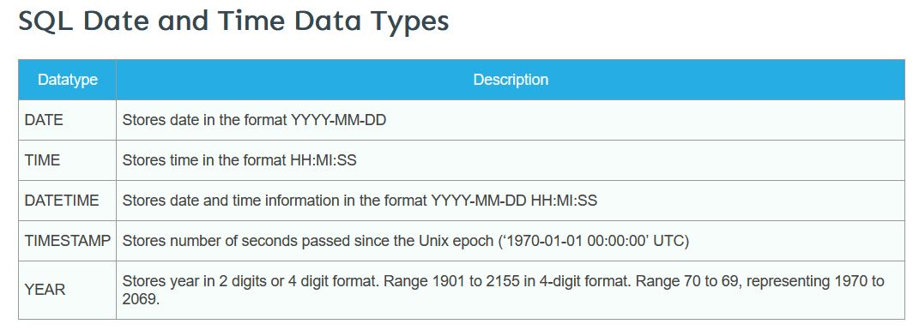
Data Types
Every relational database vendor has its own maximum size limit for different data types, you don’t need to remember the limit. Idea is to have the knowledge of what data type to be used in a specific scenario.

Slide 12
Creating table
The CREATE TABLE statement is used to create a new table in a database. SQL is not case sensitive.
Syntax:
CREATE TABLE table_name ( column1 datatype, column2 datatype, column3 datatype, .... );
Example:
CREATE TABLE Persons ( PersonID int, LastName varchar(255), FirstName varchar(255), Address varchar(255), City varchar(255) );

Slide 13
Insert Into Statement
Syntax:
INSERT INTO table_name (column1, column2, column3, ...) VALUES (value1, value2, value3, ...);
Example:
INSERT INTO Customers (CustomerName, ContactName, Address, City, PostalCode, Country) VALUES ('Cardinal', 'Tom B. Erichsen', 'Skagen 21', 'Stavanger', '4006', 'Norway');
SQL UPDATE Statement
The UPDATE statement is used to modify the existing records in a table
Syntax:
UPDATE table_name SET column1 = value1, column2 = value2, ... WHERE condition;
Example:
UPDATE Customers SET ContactName = 'Alfred Schmidt', City= 'Frankfurt' WHERE CustomerID = 1;

Slide 14
SQL DELETE Statement
The DELETE statement is used to delete existing records in a table.
Syntax:
DELETE FROM table_name WHERE condition;
Example:
The following SQL statement deletes the customer "Alfreds Futterkiste" from the "Customers" table:
DELETE FROM Customers
WHERE CustomerName='Alfreds Futterkiste';
DROP TABLE Statement
The DROP TABLE statement is used to drop an existing table in a database.
Syntax:
DROP TABLE table_name;
Example:
DROP TABLE Shippers;

Slide 15
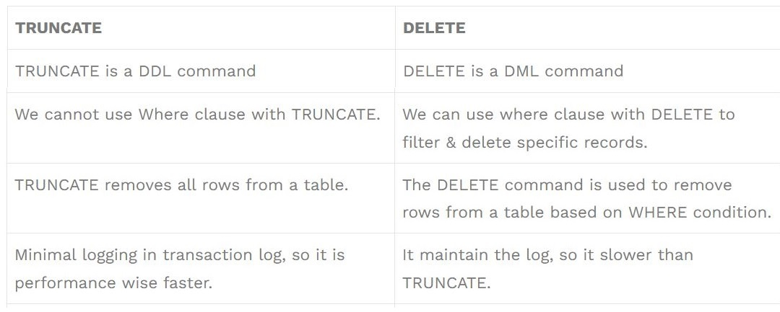
Truncate
The TRUNCATE TABLE command deletes the data inside a table, but not the table.
Syntax:
TRUNCATE TABLE table_name;
Delete Command
We use SQL Delete command in SQL Server to remove records from a table. We can remove all records or use a Where clause to remove records matching the criteria.
TRUNCATE vs DELETE

Slide 16
Practice Questions
Write a query to create a simple table Movies including columns movie_id,movie_name,release_year,rental_rate .
Write a query to insert 5 records with your own value into the table Movies against each column.The release_year must be 2016,2017,2022,2025,2023.
Write a query to insert rows from film table to Movies table.
Write a query to update the rental_rate to 9999 for those Movies whose release_year is greater than 2022.
Delete the rows from the Movies table where the rental_rate is 9999.
Drop the table Movies.

Slide 17
Chapter 2: Queries
SQL SELECT Statement
The SELECT statement is used to select data from a database. (similar to GET in postman)
Syntax:
SELECT column1, column2, ... FROM table_name;
Example:
SELECT CustomerName, City FROM Customers;
Syntax For all records:
SELECT * FROM table_name;

Slide 18
WHERE Clause
The WHERE clause is used to filter records.
It is used to extract only those records that fulfill a specified condition.
The WHERE clause is not only used in the SELECT statement, but it is also used in the UPDATE, DELETE statement, etc
Syntax:
SELECT column1, column2, ... FROM table_name WHERE condition;
ORDER BY
The ORDER BY keyword is used to sort the result-set in ascending or descending order.
The ORDER BY keyword sorts the records in ascending order by default. To sort the records in descending order, use the DESC keyword.
Syntax:
SELECT column1, column2, ...
FROM table_name
ORDER BY column1, column2, ... ASC|DESC;

Slide 19
LIKE operator
The LIKE operator is used in a WHERE clause to search for a specified pattern in a column.
There are two wildcards often used in conjunction with the LIKE operator:
The percent sign (%) represents zero, one, or multiple characters
The underscore sign (_) represents one, single character
Syntax:
SELECT column1, column2, ...
FROM table_name
WHERE columnN LIKE pattern;
SELECT * FROM Customers
WHERE CustomerName LIKE 'a%';

Slide 20
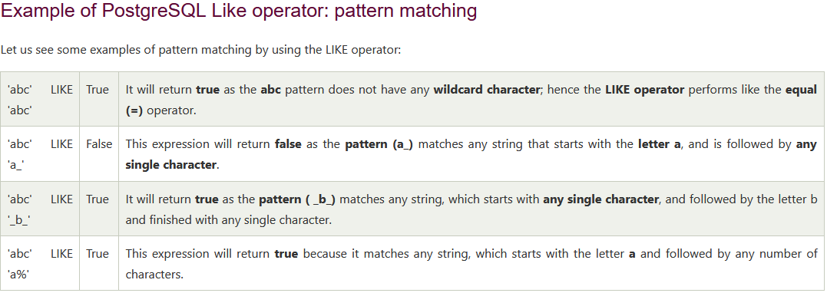
WILDCARD Characters
A wildcard character is used to substitute one or more characters in a string.
Wildcard characters are used with the LIKE operator. The LIKE operator is used in a WHERE clause to search for a specified pattern in a column.
PostgreSQL provides you with two wildcards:
Percent sign ( %) matches any sequence of zero or more characters.
Underscore sign ( _) matches any single character.

Slide 21
ALIASES
SQL aliases are used to give a table, or a column in a table, a temporary name.
The renaming is a temporary change and the actual table name does not change in the database.
Aliases are often used to make column names more readable.
An alias only exists for the duration of that query.
An alias is created with the ‘AS ‘ keyword.
To reduce the confusion when using joins.
Column Syntax:
SELECT column_name AS alias_name
FROM table_name;
Table Syntax:
SELECT column_name(s)
FROM table_name AS alias_name;

Slide 22
BETWEEN Operator
The BETWEEN operator selects values within a given range. The values can be numbers, text, or dates.
The BETWEEN operator is inclusive: begin and end values are included.
Syntax:
SELECT column_name(s)
FROM table_name
WHERE column_name BETWEEN value1 AND value2;
Example:
SELECT * FROM Products
WHERE Price BETWEEN 10 AND 20;
NOT BETWEEN: To display the products outside the range of the previous example, use NOT BETWEEN.
Example:
SELECT * FROM Products
WHERE Price NOT BETWEEN 10 AND 20;
BETWEEN Dates Example: The following SQL statement selects all orders with an OrderDate between '01-July 1996' and '31-July 1996':

Slide 23
AND, OR and NOT Operators
The WHERE clause can be combined with AND, OR, and NOT operators.
The AND and OR operators are used to filter records based on more than one condition.
The AND operator displays a record if all the conditions separated by AND are TRUE.
The OR operator displays a record if any of the conditions separated by OR is TRUE.
The NOT operator displays a record if the condition(s) is NOT TRUE.
AND Syntax:
SELECT column1, column2, ... FROM table_name WHERE condition1 AND condition2 AND condition3 ...;
OR Syntax:
SELECT column1, column2, ...
FROM table_name
WHERE condition1 OR condition2 OR condition3 ...;
NOT Syntax:
SELECT column1, column2, ...
FROM table_name
WHERE NOT condition;

Slide 24
NULL VALUES
A field with a NULL value is a field with no value.
If a field in a table is optional, it is possible to insert a new record or update a record without adding a value to this field. Then, the field will be saved with a NULL value.
Note: A NULL value is different from a zero value or a field that contains spaces. A field with a NULL value is one that has been left blank during record creation!
How to Test for NULL Values?
It is not possible to test for NULL values with comparison operators, such as =, <, or <>.
We will have to use the IS NULL and IS NOT NULL operators instead.
IS NULL Syntax:
SELECT column_names
FROM table_name
WHERE column_name IS NULL;
IS NOT NULL Syntax:
SELECT column_names
FROM table_name
WHERE column_name IS NOT NULL;

Slide 25
CONSTRAINTS IN SQL:
SQL constraints are used to specify rules for the data in a table.
Constraints are used to limit the type of data that can go into a table. This ensures the accuracy and reliability of the data in the table. If there is any violation between the constraint and the data action, the action is aborted.
Constraints can be column level or table level. Column level constraints apply to a column, and table level constraints apply to the whole table or more than one columns.
Some of the constraints in SQL are:
NOT NULL: This constraint tells that we cannot store a null value in a column. That is, if a column is specified as NOT NULL then we will not be able to store null in this particular column any more.
UNIQUE: This constraint when specified with a column, tells that all the values in the column must be unique. That is, the values in any row of a column must not be repeated.
PRIMARY KEY: A primary key is a field which can uniquely identify each row in a table. And this constraint is used to specify a field in a table as primary key.
FOREIGN KEY: A foreign key is a column or a group of columns in a table that reference the primary key of another table. And this constraint is used to specify a field as Foreign key.
CHECK: This constraint helps to validate the values of a column to meet a particular condition. That is, it helps to ensure that the value stored in a column meets a specific condition.
DEFAULT: This constraint specifies a default value for the column when no value is specified by the user.
Syntax:
CREATE TABLE table_name ( column1 datatype constraint, column2 datatype constraint, column3 datatype constraint, .... );

Slide 26
Practice Questions
Display all the names of the customers with store_id = 1.
Display all the customer names ordered in descending order of their address.
Display the addresses whose phone number is empty.
Display all the distinct years of the movie released from the films.
Display the names of the customers whose first names start with A and last name ends with ‘l’.
Display the address whose city id is in between 30 and 190.
Display the address whose city id is in between 30 and 190 and whose district is Texas.
Display all the inventories whose film id is 1 or 2.
Display all the records whose city_id is not 200.
Write a query to create a table Movies and set NOT NULL and PRIMARY KEY constraints for movie_name and movie_id .

Slide 27
WHAT IS AN AGGREGATE FUNCTION IN SQL?
Chapter 3: Aggregate Functions
An aggregate function in SQL performs a calculation on multiple values and returns a single value.
SQL provides many aggregate functions that include avg, count, sum, min, max, etc. An aggregate function ignores NULL values when it performs the calculation, except for the count function.
COUNT() Function:
The COUNT() function returns the number of rows in a database table.
Syntax:
SELECT COUNT(column_name) FROM table_name WHERE condition;
AVG () Function
The AVG() function returns the average value of a numeric column.
Syntax:
SELECT AVG(column_name) FROM table_name WHERE condition;

Slide 28
SUM () Function
The SUM() function returns the total sum of a numeric column.
Syntax:
SELECT SUM(column_name) FROM table_name WHERE condition;
MIN() Function
The MIN() function returns the smallest value of the selected column.
MIN() Syntax:
SELECT MIN(column_name) FROM table_name WHERE condition;
MAX() function
The MAX() function returns the largest value of the selected column.
MAX() Syntax:
SELECT MAX(column_name) FROM table_name WHERE condition;

Slide 29
GROUP BY Statement
HAVING Clause
The GROUP BY statement groups rows that have the same values into summary rows.
The GROUP BY statement is often used with aggregate functions (COUNT(), MAX(), MIN(), SUM(), AVG()) to group the result-set by one or more columns.
GROUP BY Syntax
SELECT column_name(s) FROM table_name WHERE condition GROUP BY column_name(s) ORDER BY column_name(s);
Important Points:
GROUP BY clause is used with the SELECT statement.
In the query, GROUP BY clause is placed after the WHERE clause.
In the query, GROUP BY clause is placed before ORDER BY clause if used any.
The HAVING clause was added to SQL because the WHERE keyword cannot be used with aggregate functions.
HAVING Syntax
SELECT column_name(s) FROM table_name WHERE condition GROUP BY column_name(s) HAVING condition ORDER BY column_name(s);

Slide 30
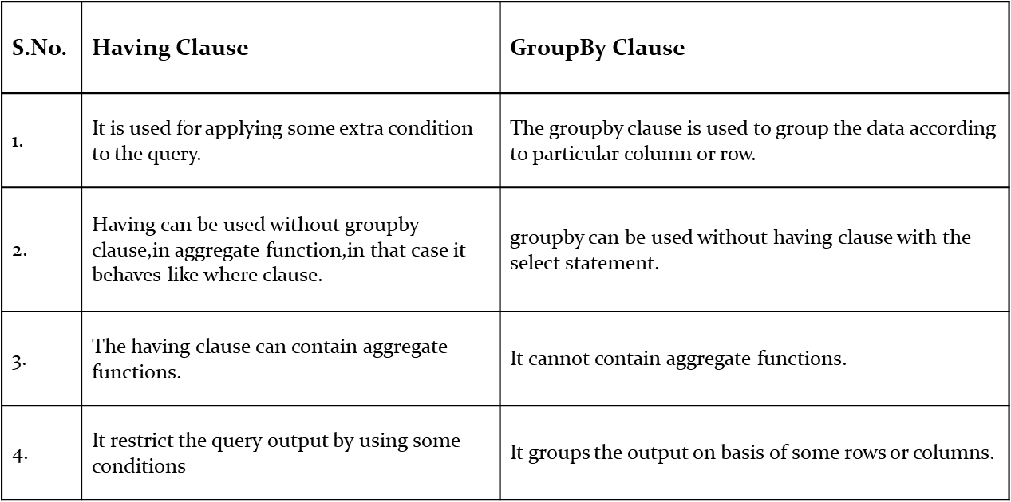
DIFFERENCE BETWEEN HAVING CLAUSE AND GROUP BY CLAUSE :

Slide 31
Practice Questions
What is the movie(s) that was rented the most.
Display each movie and the number of times it got rented.
Show the number of movies each actor acted in.
Display the names of the actors that acted in more than 20 movies.
For each store, display the number of customers that are members of that store.
What is the highest total_payment done.
What is the name of the customer who made the highest total payments.
Display each movie and the number of times it got rented.
How many actors have 8 letters only in their first_names.
Display the movies offered for rent in store_id 1 and not offered in store_id 2.
Display the movie title for the most rented movie in the store with store_id 1.

Slide 32
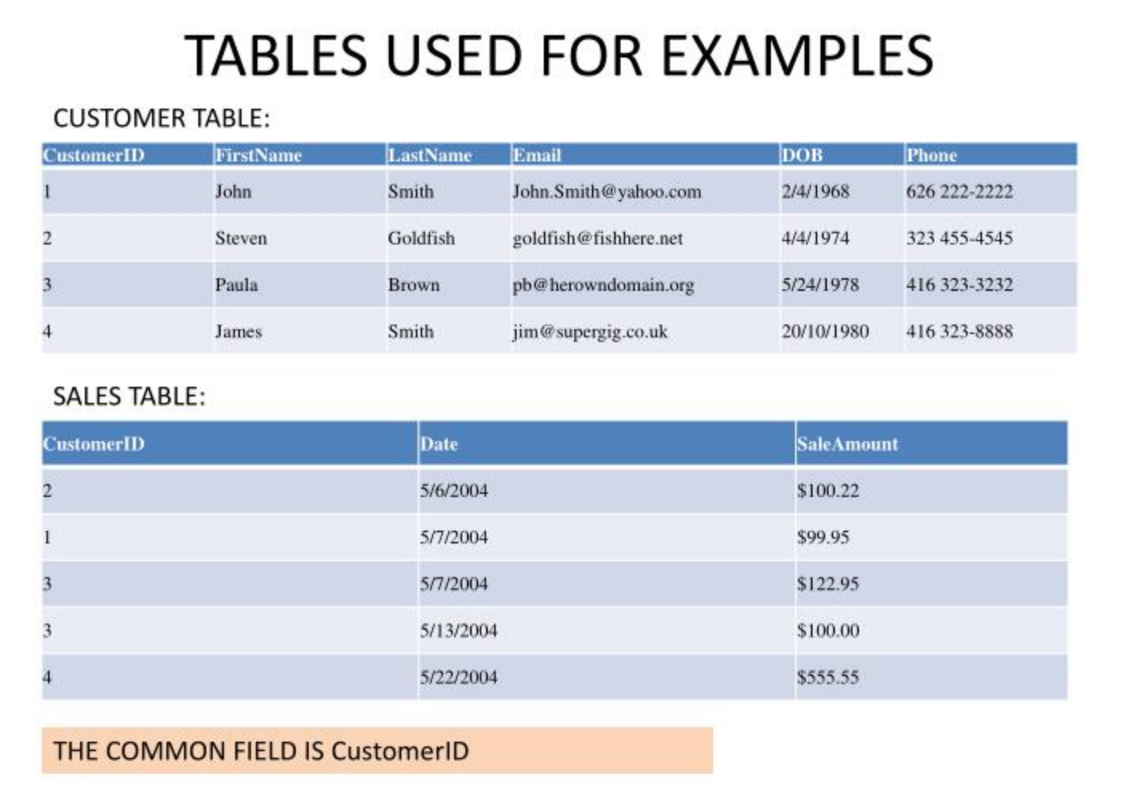
Why Use a Join?
Chapter 4: SQL Joins and Sub Queries
The SQL JOIN clause is used whenever we have to select data from 2 or more tables.
Join clause used to combine rows from two or more tables based on a related column between them.

Slide 33
Primary Key
A primary key is a column or a group of columns in a table that uniquely identifies the rows in that table.
Primary keys must contain UNIQUE values, and cannot contain NULL values.
A table can have only ONE primary key; and in the table, this primary key can consist of single or multiple columns (fields).
PRIMARY KEY on CREATE TABLE:
For single column:
CREATE TABLE Persons (
ID int NOT NULL PRIMARY KEY,
LastName varchar(255) NOT NULL,
FirstName varchar(255),
Age int
);
For multiple columns:
CREATE TABLE Persons (
ID int NOT NULL,
LastName varchar(255) NOT NULL,
FirstName varchar(255),
Age int,
CONSTRAINT PK_Person PRIMARY KEY (ID,LastName)
);

Slide 34
FOREIGN KEY
A FOREIGN KEY is a column or group of columns in a table, that refers to the PRIMARY KEY in another table.
The table with the foreign key is called the child table, and the table with the primary key is called the referenced or parent table.
The FOREIGN KEY constraint is used to prevent actions that would destroy links between tables. Which means Foreign key don’t allow values other than parent table.
Specifying foreign key:
CREATE TABLE Orders ( OrderID int NOT NULL PRIMARY KEY, OrderNumber int NOT NULL, PersonID int FOREIGN KEY REFERENCES Persons(PersonID) );

Slide 35
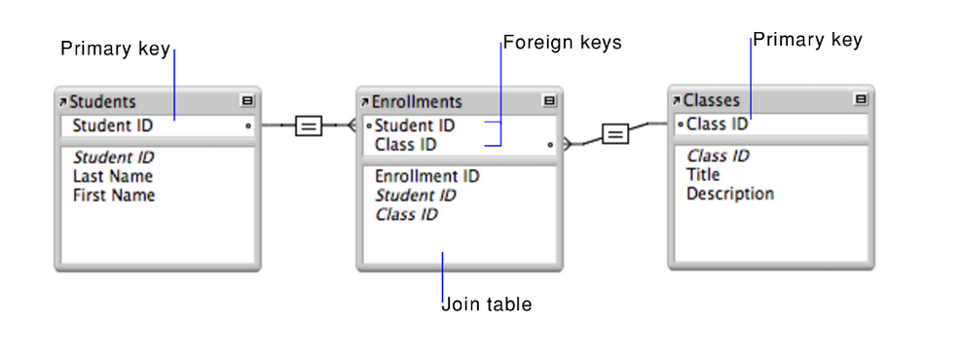
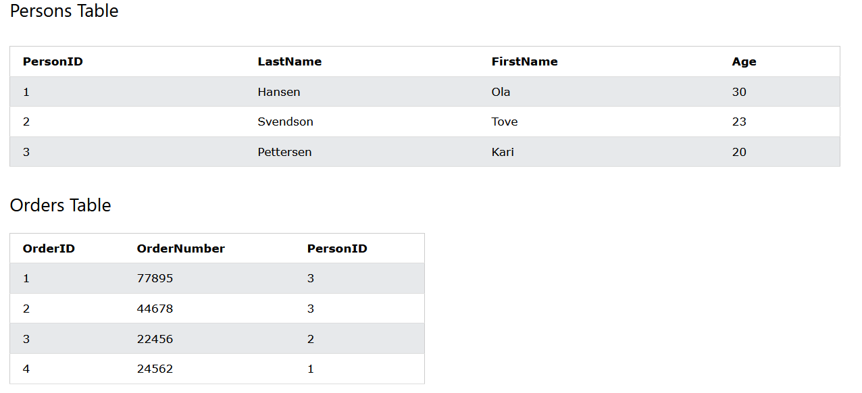
Examples:

Slide 36
SELF JOIN
A self join allows you to join a table to itself. It helps query hierarchical data or compare rows within the same table.
A self join uses the inner join or left join clause. Because the query that uses the self join references the same table, the table alias is used to assign different names to the same table within the query.
Self join syntax:
SELECT column_name(s) FROM table1 T1, table1 T2 WHERE condition;

Slide 37
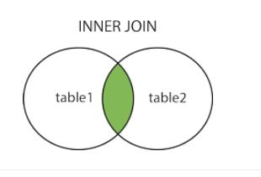
Joins
Join clause used to combine rows from two or more tables. based on a related column between them.
Using a Primary key and foreign keys which has a common relationship between two tables.
Inner Join:
Returns records that have matching values in both tables.
Syntax:
SELECT column_name(s)
FROM table1
INNER JOIN table2
ON table1.column_name = table2.column_name;

Slide 38
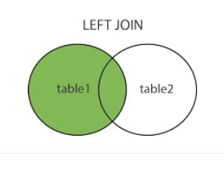
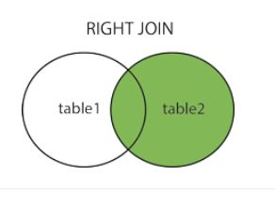
LEFT JOIN
The LEFT JOIN keyword returns all records from the left table (table1), and the matching records from the right table (table2). The result is 0 records from the right side, if there is no match.
Syntax:
SELECT column_name(s)
FROM table1
LEFT JOIN table2
ON table1.column_name = table2.column_name;
RIGHT JOIN
The RIGHT JOIN returns all records from the right table (table2), and the matching records from the left table (table1). The result is 0 records from the left side, if there is no match.
Syntax:
SELECT column_name(s)
FROM table1
RIGHT JOIN table2
ON table1.column_name = table2.column_name;

Slide 39
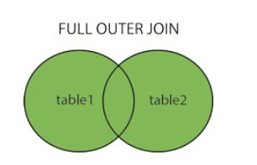
FULL OUTER JOIN
The FULL OUTER JOIN returns all records when there is a match in left (table1) or right (table2) table records.
FULL OUTER JOIN and FULL JOIN are the same.
Syntax:
SELECT column_name(s)
FROM table1
FULL OUTER JOIN table2
ON table1.column_name = table2.column_name
WHERE condition;

Slide 40
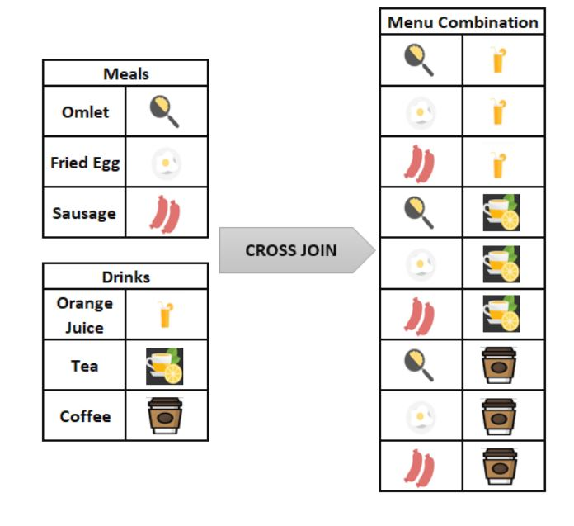
CROSS JOIN
The CROSS JOIN is used to generate a paired combination of each row of the first table with each row of the second table. This join type is also known as Cartesian join. What is the Cartesian Product?
The Cartesian Product is a multiplication operation in the set theory that generates all ordered pairs of the given sets. Suppose that, A is a set and elements are {a,b} and B is a set and elements are {1,2,3}. The Cartesian Product of these two A and B is denoted AxB and the result will be like the following.
AxB ={(a,1), (a,2), (a,3), (b,1), (b,2), (b,3)}
Syntax:
SELECT ColumnName_1, ColumnName_2, ..
FROM Table_1
CROSS JOIN Table_2

Slide 41
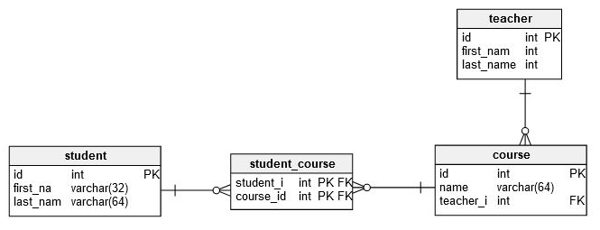
THREE TABLES JOIN EXAMPLE:
SELECT
student.first_name,
student.last_name,
course.name
FROM student
JOIN student_course
ON student.id = student_course.student_id
JOIN course
ON course.id = student_course.course_id;

Slide 42
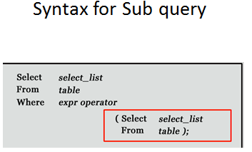
SUB QUERY
Definition-- A sub query or Inner Query is a query within Another Query and embedded within Where clause
It is also called as Nested query.
Sub query is used to return data that will be used in main query to further restrict data retrieve.
In PostgreSQL subquery can be nested inside a SELECT, UPDATE, INSERT, DELETE statements along with the expression operators like =, <, >, >=, <=, IN, BETWEEN, etc
The first statement is known as the outer query, the second is known as the inner query or sub query. The inner query or sub query is normally executed first.
The sub query can be placed in the following SQL clauses they are WHERE clause, HAVING clause, FROM clause.
The sub query (inner query) executes once before the main query (outer query) executes.
The main query (outer query) use the sub query result.

Slide 43
RULES TO WRITE SUB QUERY
Subqueries must be enclosed within parentheses.
A subquery can have only one column in the SELECT clause, unless multiple columns are in the main query for the subquery to compare its selected columns.
An ORDER BY command cannot be used in a subquery, although the main query can use an ORDER BY. The GROUP BY command can be used to perform the same function as the ORDER BY in a subquery.
Subqueries that return more than one row can only be used with multiple value operators such as the IN operator.
A subquery cannot be immediately enclosed in a set function.
The BETWEEN operator cannot be used with a subquery. However, the BETWEEN operator can be used within the subquery.
A subquery is always placed on the right side of the comparison operators.
Subqueries will with ALL, ANY, IN, or SOME
Subqueries will with EXISTS or NOT EXISTS

Slide 44
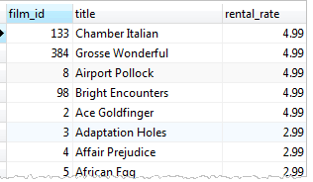
EXAMPLES OF SUBQUERY
Suppose we want to find the films whose rental rate is higher than the average rental rate. We can do it in two steps:
First Find the average rental rate by using the SELECT statement and average function ( AVG).
select * from film;
SELECT
AVG (rental_rate)
FROM
film; Ans :- avg 2.98
Means The average rental rate is 2.98
Second Use the result of the first query in the second SELECT statement to find the films that we want.
Now we can get those films whose rental rate is higher than average rental rate
SELECT
film_id,
title,
rental_rate
FROM
film
WHERE
rental_rate > 2.98;
Answer🡪

Slide 45
Lets try new query for sub query
As earlier mentioned subquery is a query nested inside another query such as SELECT, INSERT, DELETE and UPDATE. In this tutorial, we are focusing on the SELECT statement only.
To construct a subquery, we put the second query in brackets and use it in the WHERE clause as an expression:
SELECT
film_id,
title,
rental_rate
FROM
film
WHERE
rental_rate > (
SELECT
AVG (rental_rate)
FROM
film
);
The query inside the brackets is called a subquery or an inner query. The query that contains the subquery is known as an outer query.
PostgreSQL executes the query that contains a subquery in the following sequence:
a. First, executes the subquery.
b. Second, gets the result and passes it to the outer query.
c. Third, executes the outer query.

Slide 46
Types of sub queries
1. Scalar Subquery: Is a Single Row Subquery. Which will return one row and one column in the result.
EX:
SELECT film_id, title, rental_rate --outer query/main query
FROM film
WHERE rental_rate > ( SELECT AVG (rental_rate FROM film );
2. Multiple Row Subquery : There are two types of multiple row sub query.
Subquery which returns multiple column and multiple row
Subquery which returns only 1 column and multiple rows.

Slide 47
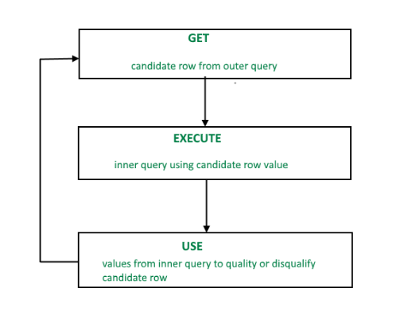
3. Correlated Subquery: Correlated subqueries are used for row-by-row processing. Each subquery is executed once for every row of the outer query. Multiple Column Subqueries. Returns one or more columns.
Syntax:
SELECT column1, column2, ....
FROM table1 outer
WHERE column1 operator
(SELECT column1, column2
FROM table2
WHERE expr1 = outer.expr2);
A correlated subquery is evaluated once for each row processed by the parent statement. The parent statement can be a SELECT, UPDATE, or DELETE statement.

Slide 48
PostgreSQL subquery with EXISTS operator
The EXISTS operator is a boolean operator that tests for existence of rows in a subquery.
The following illustrates syntax of the EXISTS operator: EXISTS (subquery)
A subquery can be an input of the EXISTS operator. If the subquery returns any row, the EXISTS operator returns true. If the subquery returns no row, the result of EXISTS operator is false.
The EXISTS operator is often used with the correlated subquery.
The result of EXISTS operator depends on whether any row returned by the subquery, and not on the row contents. Therefore, columns that appear on the SELECT clause of the subquery are not important.
Syntax:
SELECT column1 FROM table_1
WHERE EXISTS( SELECT 1
FROM table_2
WHERE table_2.column_2 = table_1.column_1);
Note that if the subquery returns NULL, the result of EXISTS is true.

Slide 49
Advantages Of Sub query
Sub-queries can be very useful to select rows from a table with a condition that depends on the data in the same or another table.
Sub queries divide the complex query into isolated parts so that a complex query can be broken down into a series of logical steps.
It is easy to understand and code maintenance is also at ease.
Sub queries allow you to use the results of another query in the outer query.
In some cases, subqueries can replace complex joins.
Disadvantages of Sub query
We cannot modify a table and select from the same table within a subquery in the same SQL statement.
In many cases sub query will execute more efficiently if we rewrite the sub-query as a Join

Slide 50
Query optimization:
SQL Query optimization is defined as the iterative process of enhancing the performance of a query in terms of execution time, the number of disk accesses, and many more cost measuring criteria.
It is achieved using
Define requirement
Reduce table size
Simplify joins
Use SELECT Fields FROM Instead of SELECT * FROM– it reduces data fetching
Use EXISTS() Instead of COUNT()
Conclusion :
A sub query is easier to write, but a joint might be better optimized by the server.
E.g a Left Outer join typically works faster because servers optimize it.

Slide 51
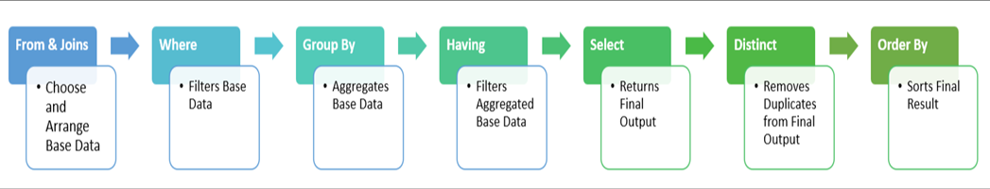
SQL Query Order Of Execution
The SQL order of execution defines the order in which the clauses of a query are evaluated. Some of the most common query challenges people run into could be easily avoided with a clearer understanding of the SQL order of execution, sometimes called the SQL order of operations. Understanding SQL query order can help you diagnose why a query won’t run, and even more frequently will help you optimize your queries to run faster.
This order is:

Slide 52
Practice Questions
1. Find the names of the customers had bought DVD for rent for more than 5 days?
2. Find the city with maximum number of Staff ?
3. Find the Staff Names in a city "Barcelona"?
4. List all the stores with their address.
5. Find the films which were not rented ?
6. Find the film which has maximum number of inventory ?
7. Find the name of the store which has maximum inventory ?
8. Find the actors who have not acted in a film ?
9. Show the number of rented movies under each rating.

Slide 53
Chapter 5: Views
Views
Definition-- Views are pseudo-tables.
A view can represent a subset of a real table, selecting certain columns or certain rows from an ordinary table.
A view can contain all rows of a table or selected rows from one or more tables.
A view can be created from one or many tables, which depends on the written PostgreSQL query to create a view.
The basic CREATE VIEW syntax is as follows −
CREATE [TEMP | TEMPORARY] VIEW view_name AS
SELECT column1, column2.....
FROM table_name
WHERE [condition];
We can include multiple tables in our SELECT statement in very similar way as you use them in normal PostgreSQL SELECT query. If the optional TEMP or TEMPORARY keyword is present, the view will be created in the temporary space. Temporary views are automatically dropped at the end of the current session.
So if we not use TEMP keyword, the view be created in permanent space and it will be available until we cant drop it by writing Drop query.

Slide 54
Examples:
A simple trail query to create view
Create view Hello As select ‘Hello world’;
select * from Hello;
Answer: Hello world
Just create a view from Employee table
CREATE VIEW EMP _VIEW AS SELECT emp_id, salary FROM employee;
This will create the view for table Employee.
SELECT * FROM COMPANY_VIEW; ---. This query will give same table view with selected columns
Create view with Where condition
select * from employee;
create view emp_view
As select emp_id, emp_name from employee
where emp_id = 110;
select * from emp_view;

Slide 55
View with Join
CREATE or REPLACE VIEW current_inventory AS
SELECT product_name, quantity, category_name
FROM products
INNER JOIN categories
ON products.category_id = categories.category_id
WHERE quantity > 0;
CAUTION:
The CREATE OR REPLACE VIEW statement will work if you are adding columns to the view at the end of the list. However, it will error if you are adding new columns within the existing columns (ie: start or middle of the existing list). In this case, do not use the CREATE OR REPLACE VIEW statement. It is better to drop the view and use the CREATE VIEW statement!
DROP VIEW [IF EXISTS] view_name
view_name
The name of the view that you wish to drop.
IF EXISTS
Optional. If you do not specify this clause and the VIEW does not exist, the DROP VIEW statement will return an error.
E.g. DROP VIEW EMP_VIEW;

Slide 56
Practice Questions
Create view on table film on columns film_id and title.
Create a view to locate the rental_rate is 4.99 .
Drop the view for the table film.

Slide 57
INDEX
Chapter 6: Index
An Index is the structure or object by which we can retrieve specific rows or data faster.
Index is a data structure which we will built and assign upon existing table that basically look through table and try analyze and summarize to create short cuts to retrieve data.
There are various types of indexes in SQL server:
B-Tree
Hash
GiST
SP-GiST
GIN
BRIN
The basic syntax of CREATE INDEX is as follows −
CREATE INDEX index_name ON table_name;
There are some ways to create Index
1. Single-Column Indexes
Syntax:
CREATE INDEX index_name
ON table_name (column_name);
2. Multicolumn Indexes
Syntax:
CREATE INDEX index_name ON table_name (column1_name, column2_name);

Slide 58
3. Unique Indexes
Syntax:
CREATE UNIQUE INDEX index_name
on table_name (column_name);
4. Partial Indexes
Syntax:
CREATE INDEX index_name on table_name (conditional_expression);
E.G1. select * from customer;
[select table]
2. CREATE INDEX customer_id_index ON customer (customer_id);
[This will create Index on customer_id column]
We can drop Index by using Drop command
Syntax:
DROP INDEX index_name;
Index with where condition-🡪
Create Index emp_id_index ON employee(emp_id)
where emp_id=102;

Slide 59
Practice Questions
1. Create index on ‘film’ table.
2. Create index on the on the ‘customer’ table using the first_name and the last_name.
3. Write a Query to drop the indexes.

Slide 60
Chapter 7: Trigger
PostgreSQL Triggers are database callback functions, which are automatically performed/invoked when a specified database event occurs.There are 2 Levels of trigger
A. A trigger that is marked FOR EACH ROW is called once for every row that the operation modifies.
B. And for table/statement trigger will execute only once doesn’t matter how many rows are there.
Three types of triggers:
DML (Data Manipulation Language) Triggers
DDL (Data Definition Language) Triggers
Logon Triggers
The basic syntax of creating a trigger is as follows −
CREATE TRIGGER /Replace Trigger trigger-name
[Before/After]
[Insert/Update/Delete]
ON table_name
[For each row /for a table]
[Declare statement
Begin
Executable statement(-- Trigger logic goes here....)
End ];

Slide 61
Enabling Triggers
Syntax
ENABLE TRIGGER[TRIGGER_NAME|ALL] ON[OBJECT_NAME | DATABASE | ALL
SERVER]
Disabling Triggers
Syntax
DISABLE TRIGGER[TRIGGER_NAME|ALL] ON[OBJECT_NAME | DATABASE | ALL
SERVER]
Purpose of Triggers
The main purpose of triggers is to automate execution of code when an event occurs.
Triggers are used for several purposes:
Produce additional checking during insert, update or delete operations on the affected table.
They allow us to encode complex default values that cannot be handled by default constraints.
Implement referential integrity across databases.
They allow us to control what actually happens when one performs an insert, update, or delete
on a view that accesses multiple tables.
You can calculate aggregated columns in a table using triggers.

Slide 62
Practice Questions
Create a trigger function while performing insert on the ‘film’ table.
Delete the trigger.

Slide 63
Chapter 8: Stored Procedures
What is Stored procedure?
A stored procedure is block of SQL Statements. We can give name to that block of statements or code and stored in a database.
We can save stored procedure and can be reuse multiple times.
So if you have an SQL query that you write over and over again, save it as a stored procedure, and then just call it to execute it.
We can also pass parameters to a stored procedure, so that the stored procedure can act based on the parameter value(s) that is passed.
What is a Purpose of using a procedure?
Procedures are introduced to give more power to SQL language like a user defined function.
We use Procedures when we have a requirement which is not possible to achieve just by using SQL queries.
MS SQL Syntax:
CREATE PROCEDURE procedure_name AS
sql_statement
GO;

Slide 64
PostgreSQL stored procedure Syntax:
CREATE OR REPLACE PROCEDURE PROCEDURE_NAME(PARAMETER_NAME, DATATYPE)
LANGUAGE plpgsql
AS $$
DECLARE
-- variable declaration
Begin
--PROCEDURE body – all logics
END;
$$
Language : PostgreSQL supports to write stored procedure in several different languages we need to specify language. Ex: Python, C, SQL etc.
Plpgsql : stands for Procedural Language PostgreSQL
$$ : To replace multiple single quotation marks and print as it is what ever we write between $$ $$ symbol.
Ex: select ‘ I’m John’;
Declare: where we can declare all your variables.
Begin: inside begin we can write procedure body and logic
Calling a stored procedure
To call a stored procedure, you use the CALL statement as follows:
call stored_procedure_name(argument_list);

Slide 65
Advantages of using stored procedures:
The stored procedures bring many advantages as follows:
Reduce the number of round trips between applications and database servers. All SQL statements are wrapped inside a function stored in the PostgreSQL database server so the application only has to issue a function call to get the result back instead of sending multiple SQL statements and wait for the result between each call.
Increase application performance because the user-defined functions and stored procedures are pre-compiled and stored in the PostgreSQL database server.
Reusable in many applications. Once you develop a function, you can reuse it in any applications.
Disadvantages of using PostgreSQL stored procedures:
Slowness in software development because stored procedure programming requires specialized skills that many developers do not possess.
Difficult to manage versions and hard to debug.
May not be portable to other database management systems e.g., MySQL or Microsoft SQL Server.

Slide 66
Practice Questions
Create a table. Write a stored procedure to insert data in to the created table
Write a stored procedure to select the customers who rented from
store_id 2.

Slide 67
RESOURCES
https://www.postgresqltutorial.com/
https://www.w3schools.com/sql/
https://join.codecademy.com/learn/learn-sql/
https://www.youtube.com/watch?v=C93Ed8b8Mhc
https://www.youtube.com/watch?v=9jLjUIkp78Y

